Slide 1
“I” See “U”
Corey Gitman

Slide 2
Community-Based Participatory Research (CBPR)
A collaborative research design model for researchers and partners/communities
  Partners participate in all parts of the research process
Designed to achieve community-oriented goal
More flexible form of research that is willing to adapt to new circumstances and community input
Notes:
Community Based Participatory Research is a research design model in which researchers develop partnerships with communities and collaborate with one another to achieve a community oriented-goal.
In CBPR, leaders in the community work closely with researchers in all stages of the research process:
need community leaders to DETERMINE a goal
need community leaders to IMPLEMENT interventions/methods/strategies
need community leaders to HELP REPORT observations + outcomes
MOST IMPORTANTLY, need community leaders to COMMUNICATE WHAT’S WORKING and WHAT’S NOT working in order to direct/redirect the project in the right direction.
This is a slightly less conventional research model because of its flexibility.
Researchers have a subjective involvement in the initiatives/projects
Can make changes/alterations, as necessary

Slide 3
Collaborative Effort
The teacher and I would have debriefings at the end of each visit
Based on our discussions we identified the matters we believed needed the greatest attention
Sought to address multiple issues simultaneously
Notes:
At the end of each visit, when the kids go off to eat lunch, I have a brief discussion with the teacher about how the day went. These discussions are mostly about whether or not there were behavioral issues, students’ general overall performance, specific students who improved or struggled, and general observations about the students.
On Mondays, when I visit the school, the rotations that the groups work in pertain to reading and writing. So, naturally we would discuss ways in which we could help the students in these domains.
One of the issues we both agreed on that could use greater attention was the students’ omission of vowels when spelling words (primarily three letter words).
The class has been working with the “break-it-down” technique all year (which is a largely auditory method), but students were still struggling. [DESCIBE BREAK IT DOWN TECHNIQUE]
We thought that it would be a good idea to try and convey the idea of vowels b/w consonants through a visual medium.

Slide 4
Problematic Trends
Lack of engagement
Misspelling words through omission or misplacement of vowels
  However, competent at determining consonants
  Ex: “PIN” → “PN” or “PNI”
Need for validation (especially while spelling)
Notes:
Some of the trends that we discussed in these meetings were the following:
Lack of structure + Concentration at the Word/Writing Center
Misspelling words through the omission of vowels

Slide 5
Goals
Provide structure at rotation center
Engage students and promote learned skills
Familiarize students with vowel phonemes through a new medium
Consonant, Vowel, Consonant (CVC)
Promote self-sufficiency & independence

Slide 6
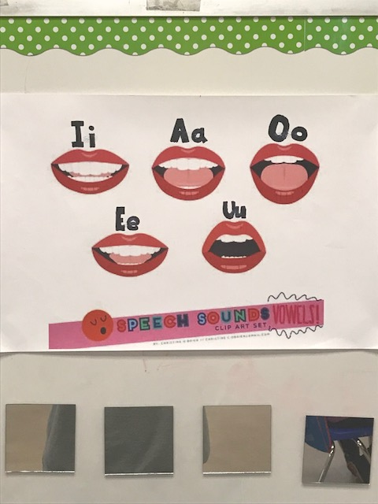
“I” See “U”
Two components to the project:
Mirrors → Identification
Chart → Reference

Slide 7
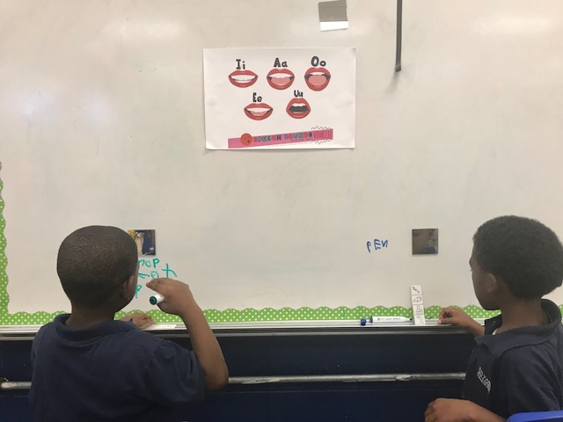
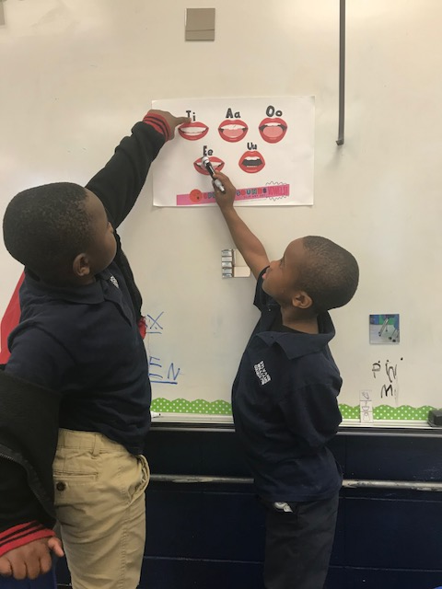
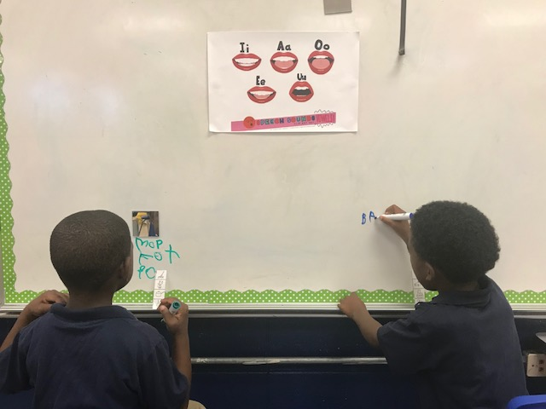
Easy As 1, 2, 3…
2) Identify the oral configuration that most closely resembles that of reflection
1) “Break-It-Down” while looking at reflection
3) Insert vowel into word!

Slide 8
Immediate Outcomes
Implemented on April 9th
Still a work in progress!!!
Preliminary efforts received mixed results
More observation is necessary in order to accurately assess effectiveness

Slide 9
Initial Challenges
Fingerprints
Fragile
  The first group dropped a mirror
Project introduction
  Manner
  Audience
Students’ wide range of academic ability

Slide 10
Continued Collaboration and Adjustments
Reconvened with teacher
Presented to entire class
  Developed structured method for how to introduce and use ”I” See “U”
    Rules
      Magnets like to stay at ”home” on the whiteboard, so slide the mirrors
      Whiteboard markers are meant for whiteboards
      Mirrors like faces, not fingers/fingerprints
    Instructional Rhyme
Teacher agreed to practice rhyme with students each day

Slide 11
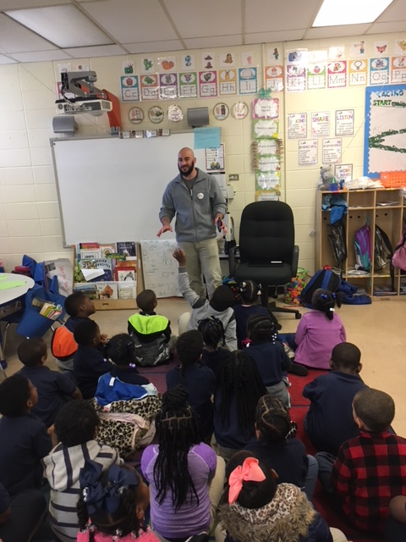
“I” See “u” Instructional Rhyme
Here is how you play,
The ”I” See “U” game!
First we ”Break-It-Down,”
And write out the first sound.
With our hands below our ears,
We look up at the mirrors.
We see our shape of face,
And look up at the chart place.
Whichever picture looks the same,
We write it down…and that’s the game!
...
But don’t forget the last sound,
Write that letter and our word is found!

Slide 12
Outcomes after adjustments
Greater student enthusiasm toward participation
Increased usage of mirrors
Increase in correct vowel placement
Possible measuring tool to track improvement
  Students’ correct spellings/rotation
    Take baseline measures
Notes:
Compared to the first week, students did not erase the white board as often after spelling words, so it was easier to see the total number of words, and those correctly spelled.

Slide 13
Lessons Learned
The necessity for collaborative efforts
  Researcher utilizing community leader to determine ultimate goal and effectively teach students with an age-appropriate strategy/lesson plan
  Community leader utilizing researcher to brainstorm new ideas from a different perspective and develop physical project
Always room for improvement

